Slide 1
Provider Prespective
Naima Mohammed Saleh
Scientific Committee Chairperson, Emirates Physiotherapy Society
Director, Mirdif Center for Physiotherapy and Rehabilitation

Slide 2
Objectives
Physiotherapy can reduce cost of health care industry
Understand risk of delay inaccess?
Documentation challenges
International Guideline for physiotherapy sessions/ duration
Imaging impact.

Slide 3
Current Policy/Guidlines Adpoted by Health Insurance for Physiotherapy
Referral from GP/ Family Physicians: decline approvals
Referal should be through specialists
Requesting X-ray and Images report for most of the musculoskletal conditions (back and neck pain, shoulder pain, knee pain etc)
Decline approval for conditions that require more than 12 or 15 sessions
Declining approval for patient with 2 diagnosis? Treat one condition then start with next diagnosis
Adhere to the body part patient referred for?
Notes:
Why Current guideline can cause increae cost or adverse event?

Slide 4
Direct access/self referral reduce cost (studies in US, UK, Australia etc) and improve health
Why current insurance policy require referal from specialist
Cost
Direct access/ self referral to physiotherapy safe (studies in US, Canada, UK, Nederland, Australia etc)
Patient safety

Slide 5
Cost
Referral/
efficacy
Number
of session
medication/
interventions
Radiology

Slide 6
Cost Effectiveness

Slide 7
Cost
Mitchell & de Lissovoy (1997)

Slide 8
Five Types of Cost Analysis in Health Care
Cost utility
Cost minimization
Cost effectiveness: relevant to physical therapy. Estimate cost and efficacy
Cost consequences
Cost benefit

Slide 9
Cost Effectivness studies-Systemic Review
Peterson et al (2009) n=95 studies used
Burge et al (2016) n=18
Both used Quality Health Economic studies
Both studies showed that PT is cost effective
Notes:
Peterson et al indicated conditions in studies reviewed (hip pain, back pain, fall prevention, cardiac conditions, arthritis, strok, majority of studies were from the UK 37, Nederland 20, US 12,

Slide 10
X-Ray & Advance Imaging

Slide 11
Early Image versus no Image and Physical Therapy
Fritz et al (2015)
Pt idedntefied from primary care visit with ICD 9 for LBP from 21 diff provider- 4 communicy based primary care
Unmatched with more more comorbitiy hypertension, older, previous surgeries,medication use include opoid , matched were more similar
Fritz et al (2015)
Notes:
American College of Radiology guidelines recommend against imaging during the first 6 weeks for uncomplicated LBP with or without radiculopathy (Davis et al. 2009).
Ethical approval optained for study, EMR reviewed: additional problem list, medication, ptidentefied as American college radiology for USLBP

Slide 12
Summery of Fritz et al (2015) study:
Patient with no advance images had significant lower
Surgeries
Injections
Specialist visit (nuro/orthopeadic/spine surgeons
Emergency department visit

Slide 13
Why Below is Not Valid
sample of insurance request we frequently recieve for approval

Slide 14
Abnormal images in Lumber spine

Slide 15
Image Lumber/cervical
radiation
3 x chest X ray
Degenerative Changes
Present asymptomatic
Chronicity/fear avoidance

Slide 16
Studies suggest that specialist visits may lead to earlier, potentially unnecessary imaging services and greater health care costs without health benefit
Fritz et al (2015) Flynn et al (2011); Srinivas et al (2012; Webster et al. (2013).

Slide 17
National Physicians Alliance, the project titled “Promoting Good Stewardship in Clinical Practice,”
5 activities in primary care for which changes in practice could lead to higher-quality care and better use of clinical resources.
One of the top 5 recommendations was “Don't do imaging for low back pain within the first 6 weeks unless red flags are present.
Srinivas et al (2012)

Slide 18
Why routine images for non specific LBP/Neck pain is not recommended?
IMAGE CAN DELAY RECOVERY
STUDIES NO DIFFERECE IN OUTCOME
FEAR AVOIDANE/ CATASTROPHIZATATION
FUNIONT /PAIN

Slide 19
Appropriate use of Diagnostic Imaging
Guideline:
Should not routinly obtain imaging or other diagnostic test for non specific LPB/neck pain
Perform Diagnostic imaging & test in presence of RED FLAGS
Perform Diagnostic image (MRI/CT) for persistent Low back& neck
after 4-6 weeks of conservative management that includes physiotherapy

Slide 20
Rotator cuff Pathology: 16.9 % of asymptomatic subject Yamamoto et al (2010)
Shoulder pathology in 19 asymptomatic baseball pitchers: 68% (tendinopathy, partial thickness tendon tear of the supraspinatus, and acromioclavicular joint osteoarthritis, respectively
Del Grande et al 2015)
Images in other Musculoskeletal conditions
Notes:
Shoulder pathology in 19 asymptomatic baseball pitchers: 68% (13/19), 32%, (6/19), and 21% (4/19) showed tendinopathy, partial thickness tendon tear of the supraspinatus, and acromioclavicular joint osteoarthritis, respectively

Slide 21
Does finding explains all the time shoulder pain?
From imaging prespective:
studies which shows falls positive results when dealing with shoulder pathologies which may increase the rates surgeries as well as phsyiotherapy cost due to stablishing diagnosis that does not exist
Pain could be from neck (sub acromial bursa C5/6)
Trigger Point
Free nerve ending from other structures etc

Slide 22
Surgeries/ Medication

Slide 23
Miniscus surgery: Arthroscopic partial menisectoy since 1990: UK 150,000 in UK and 5 times in US (Jarvinin & Guyatt 2010)
Sihovonen et al (2018) showed APM versus placebo no significant difference
Katz et al (2013) no significant differene outcome measure
De Graaf et l (2018) PT is Cost effectivenss versus APM (QALY)

Slide 24
APS Versus no menisectomy no sigificant diffenrec in outcome meausres related to function and qulaity of life

Slide 25
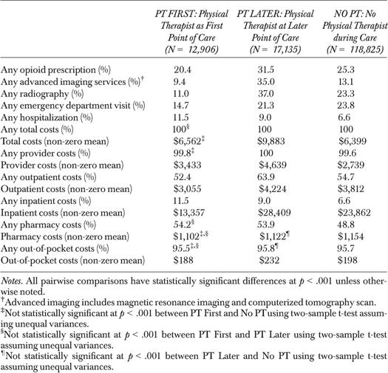
Impact of PT on Opioid in LBP patient
Descriptive Outcome Measures of Study Sample of Patients with Low Back Pain by Point of Care by Physical Therapist, 2009–2013
Frogner et al 2018

Slide 26
Referal

Slide 27
Adhere to specified diagnosis patient referred for?
Shoulder pain:
Neck
Tx spine
Neck pain
Thoracic stiffness
Radiatign pain to scapula
Low back pain :
Lower Tx, hip pathology
Knee pain
Hip, foot
Hip:
Low back pain

Slide 28
Post Operative Rehabilitation
ACLR: 20-25 session
Pre-op Physiotherapy contribute significatly to ACLR success
RCR Protocol: around 20 session in 4-6 month
Current practice: 12-15 sessions per diagnosis ???
ACLR protocol extends up to 9/12 in sport (assist in reducing the risk of ACL rupture (ACLR rupture 30%)
Massachusetts General Hospital Sports Medicine

Slide 29
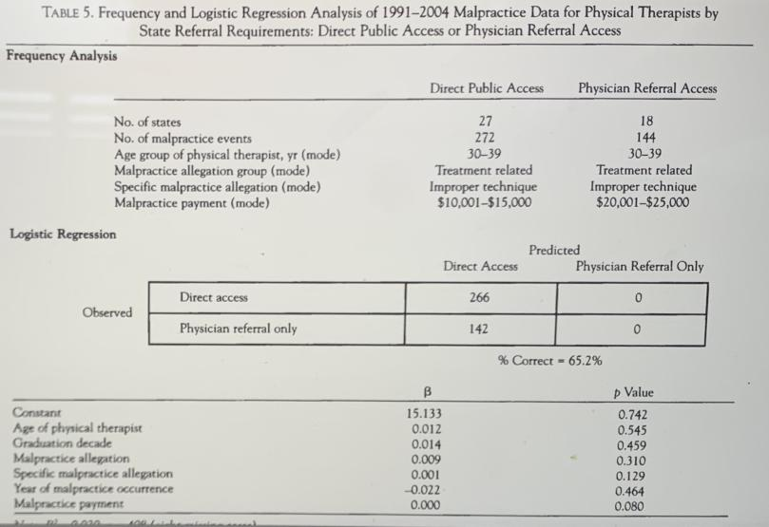
Patient Safety

Slide 30
Magnitude of Malpractice in US
Malpractice report are an indicator of patient harm

Slide 31
Magnitude of Malpractice in US
National Practitioner data bank public sue data file 1990-2004:
PT Malpractices very small: 2.7 per 10,000 PT vs 141.0 per 1,000 physicians
Of total Malpractice in US from NPBD (nationa practionnair band data) is 0.17%
The catastrophic event due to malpractices was very rare
Public policy related to direct access to PT without Physician refferal was unrelated to malpractice
Majority was related to intervention
Sandstrom (2007) journal of Allied Health.

Slide 32
Malpractice & Adverse Events
Moor et al (2005): malpractice in military health care facilities
related to delay access and patient fall
Dinningere et al (2018) comparison of adverse event with DA& physician referal between 2012-2014
No serious advers event noted in pateint chart with DA

Slide 33
Recording timing for each CPT code?????
Document next to each intervention CPT time????
Manual therapy (15 min), soft tissue mob (15 min) therapeutic exc (15 min)

Slide 34
Conclusion
Physiotherapy proved to reduce cost:
Direct access reduce the daly of physiothary intervention
Reduce the risk of chronicity
Reduce exposture to un-necessary radiation
Reduce number of image
Reduce the nubmer of the session patient needs for therapy
Reduce absenteeism from work
Reduce risk of opioid use

Slide 35
Recommendation
Physiotherapy Interventions are safe/not life threatening
Direct access is legal in the UAE as it is in all of other developed countries. Therefore, insurance companies in the UAE need to benchmark with those countries.
Family physicians/GP referral should be accepted
Images should not be requested before 4 to 6 weeks of physiotherapy unless sign of red flag or progressive pain

Slide 36
THANK YOU

Slide 37
Ref
Eric Sun, MD, PhD; Jasmin Moshfegh, MA, MSc; Chris A. Rishel, MD, PhD; et al. Association of Early Physical Therapy With Long-term Opioid Use Among Opioid-Naive Patients With Musculoskeletal Pain. Anesthesiology December 14, 2018
Schaffer AC, Jena AB, Seabury SA, Singh H, Chalasani V, Kachalia A. Rates and characteristics of paid malpractice claims among US physicians by specialty, 1992-2014. JAMA internal medicine. 2017 May 1;177(5):710-8.
Yamamoto A, Takagishi K, Osawa T et al (2010) Prevalence and risk factors of a rotator cuff tear in the general population. J shoulder Elbow Surgery, 19 pp 116-20
Del Grande F, Aro M, Jalali Farahani S et al (2015) High Resolution 3-T magnetic resonance imaging of the shoulder in nonsymptomatic porfessional baseball pitcher draft risk. J comput assist tomogr, 40 (1), 118-25

Slide 38
February 13, 2008
Expenditures and Health Status Among Adults With Back and Neck ProblemsBrook I. Martin, MPH; Richard A. Deyo, MD, MPH; Sohail K. Mirza, MD, MPH; et alJudith A. Turner, PhD; Bryan A. Comstock, MS; William Hollingworth, PhD; Sean D. Sullivan, PhDAuthor Affiliations Article Information JAMA. 2008;299(6):656-664. doi:10.1001/jama.299.6.656
Physical Therapy or Advanced Imaging as First Management Strategy Following a New Consultation for Low Back Pain in Primary Care: Associations with Future Health Care Utilization and Charges
Julie M. Fritz, Gerard P. Brennan, and Stephen J. Hunter Health Research and Educational 1940 HSR: Health Services Research 50:6 (December 2015)

Slide 39
Fumihiko Kato • Yasutsugu Yukawa • Kota Suda • Masatsune Yamagata (2012) Normal morphology, age-related changes and abnormal findings of the cervical spine. Part II: magnetic resonance imaging of over 1,200 asymptomatic subjects, Eur Spine J (2012) 21:1499–1507
Schers H, Wensing M, Huijsmans Z, van Tul- der M, Grol R. Implementation barriers for general practice guidelines on low back pain a qualitative study. Spine (Phila Pa 1976). 2001;26:E348-353
Sandstorm R (2007) Malpractice by Physical therapist: Descriptive analysis report in the national practitioner Data Bank public use Data file; 1001-2004

Slide 40
A variety of abnormal findings such as spinal cord compression, signal changes in T2 images, Arnold–Chiari malformations, and OPLL were recognized; in addition, their prevalence was surprisingly high. These abnormal findings were all seen on cervical MRIs obtained from asymptomatic volunteers. These data emphasize on the dangers of predicating operative decisions on diagnostic tests without precisely correlating MRI findings with clinical signs and symptoms. Kato et al (2012)
Image can increase risk of chronicity in pt with LBP (Schers et al 2001, Flynn et al 2012

Slide 41
International insurance companies consults us with patients treatment pathways and occupational MSK fitness.

